Slide 1
XAML for Windows 10: Controls
Daren May | President, CRANK211
Jerry Nixon| Developer Evangelist, Microsoft

Slide 2
Course Modules
XAML for Windows 10: Controls
01 | Control Fundamentals
02 | Styling and resources
03 | Custom controls

Slide 3
Agenda
Styling basics
Let's play a game
Advanced styling

Slide 4
Styling

Slide 5
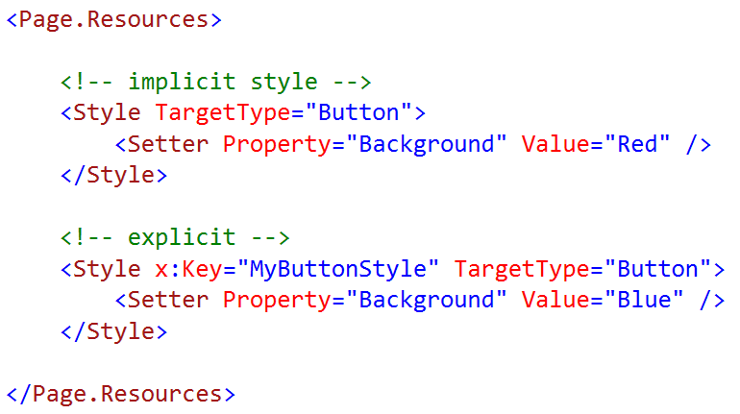
Basic style
The style above only applies to a Button
The style above only sets the Button.Background
The style above sets the Button.Background to "Red"
The string "Red" is converted automatically to a SolidColorBrush.
XAML platform type converters cannot be extended

Slide 6
Implicit versus explicit styles

Slide 7
Styling a control

Slide 8

Let's play a game
What color is the button?

Slide 9
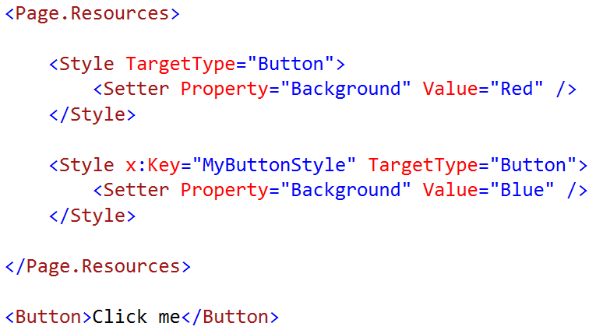
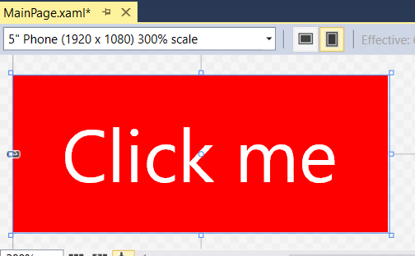
What color is the button? Implicit value

Slide 10
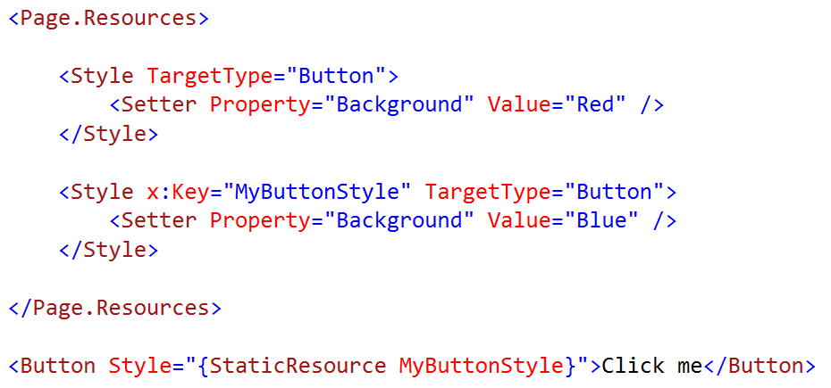
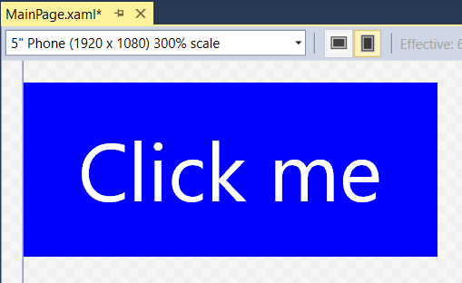
What color is the button? Explicit value

Slide 11
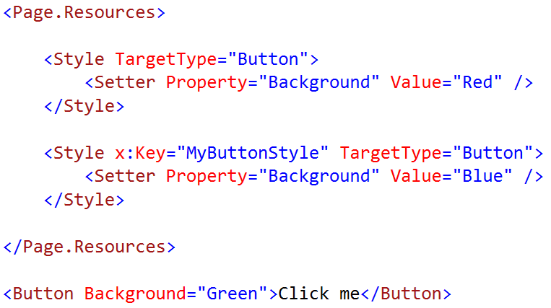
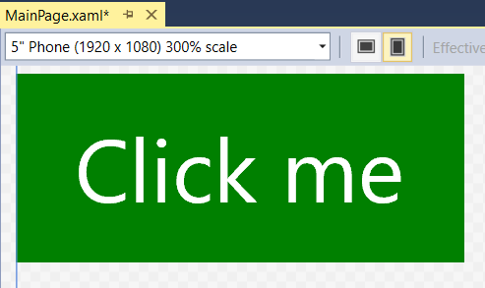
What color is the button? Local value

Slide 12
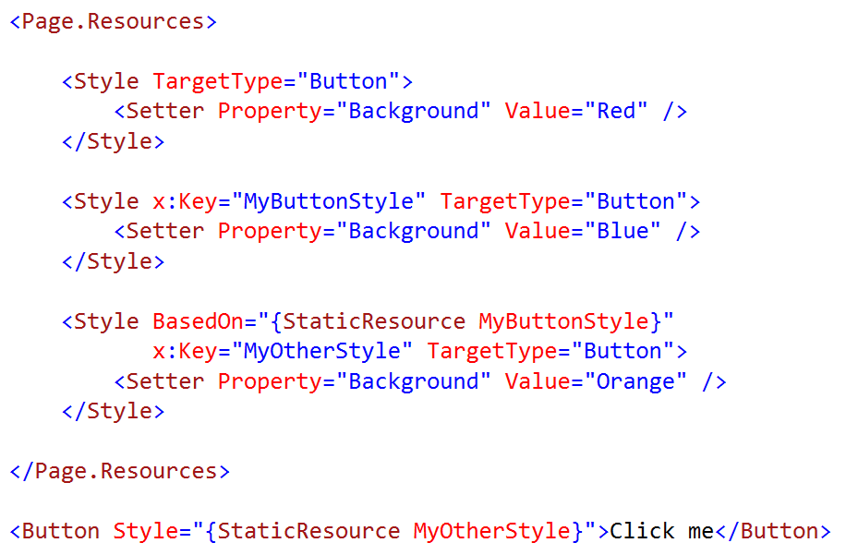
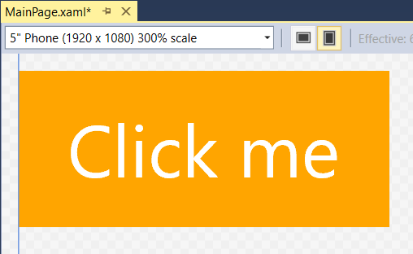
What color is the button? Cascading styles

Slide 13
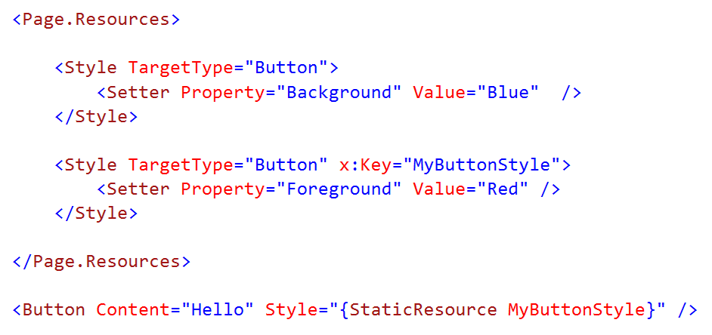
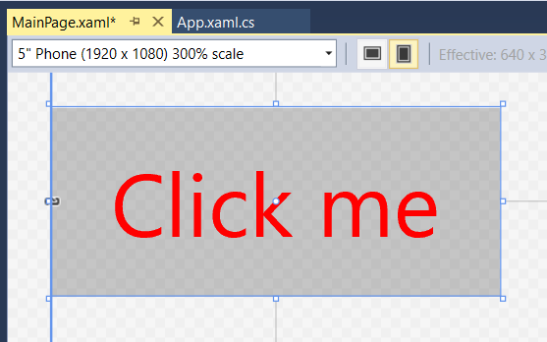
What color is the button? Cascading implicit

Slide 14
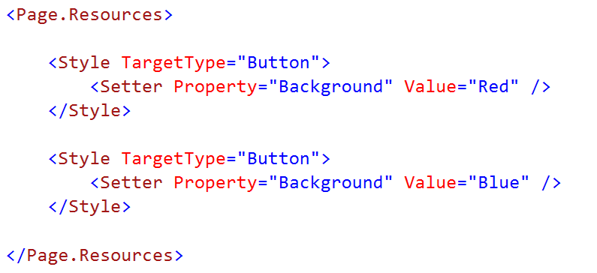
What color is the button? Style precedence

Slide 15
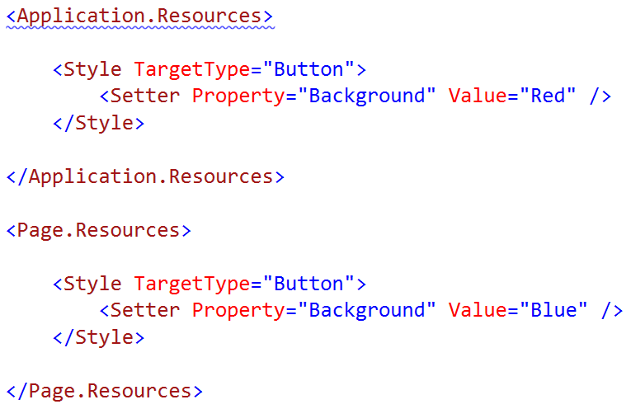
What color is the button? Style precedence

Slide 16
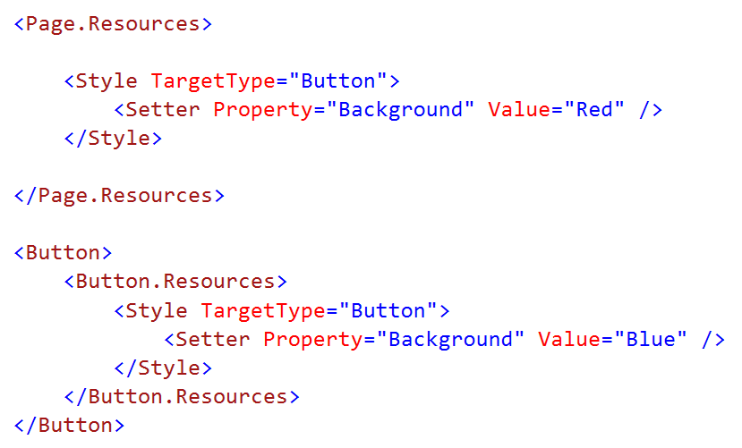
What color is the button? Local resources

Slide 17
Style precedence
Default / Generic.xaml
Application
Page
Container
Control (local)
Control (local)

Slide 18
Themes\Generic.xaml
Contains default styles
Contains default templates
Gets applied before App/Page/Control
Automatically included / compiled to PRI

Slide 19
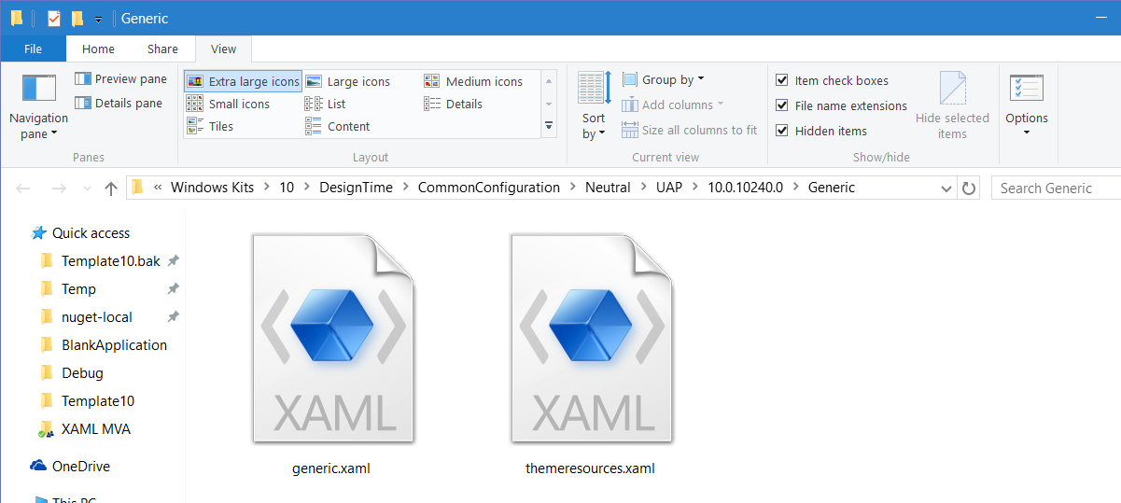
Generic.xaml
C:\Program Files (x86)\Windows Kits\10\DesignTime\ CommonConfiguration\Neutral\UAP\10.0.10240.0\Generic

Slide 20
A little more advanced

Slide 21
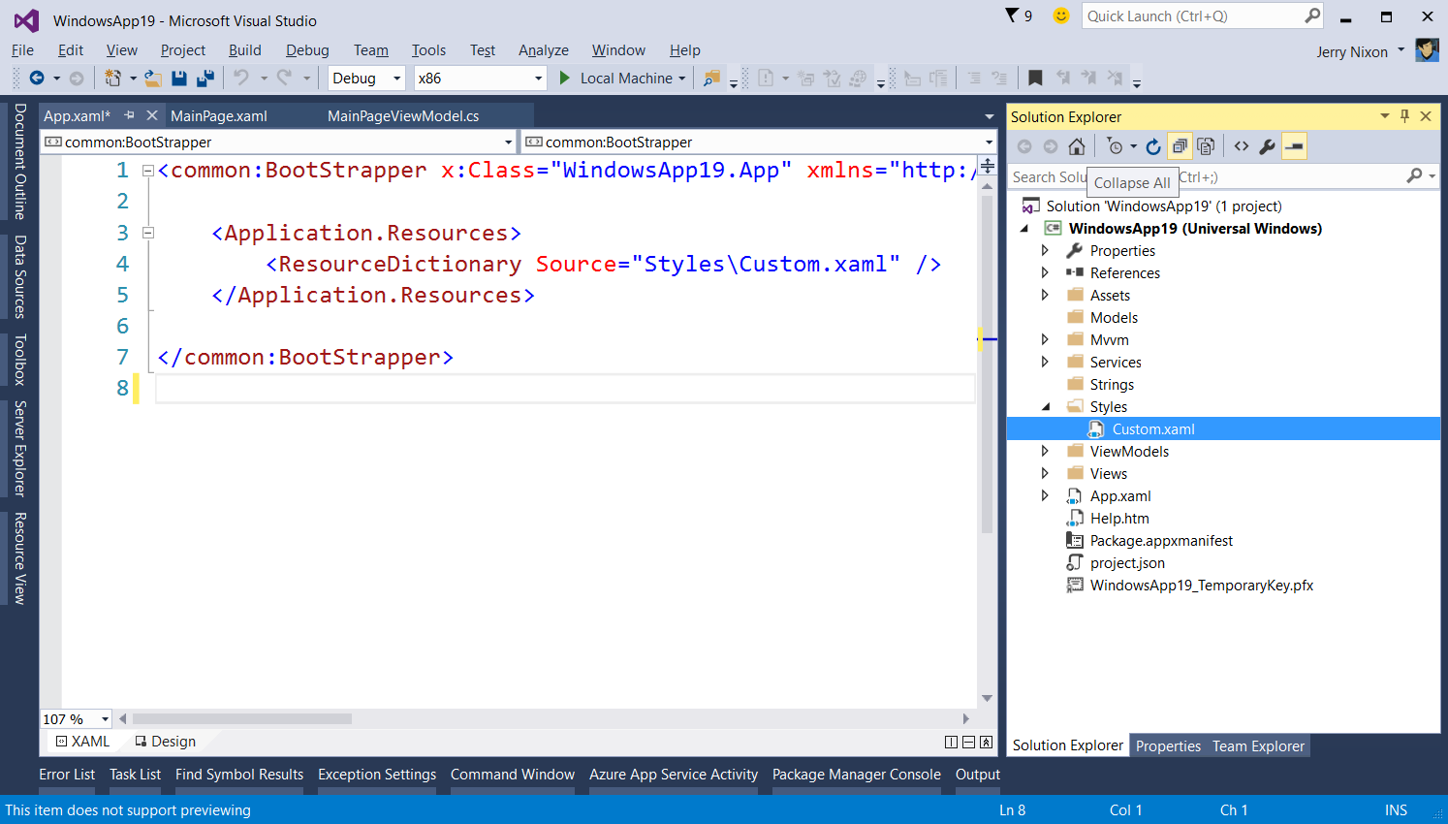
Remote dictionaries

Slide 22
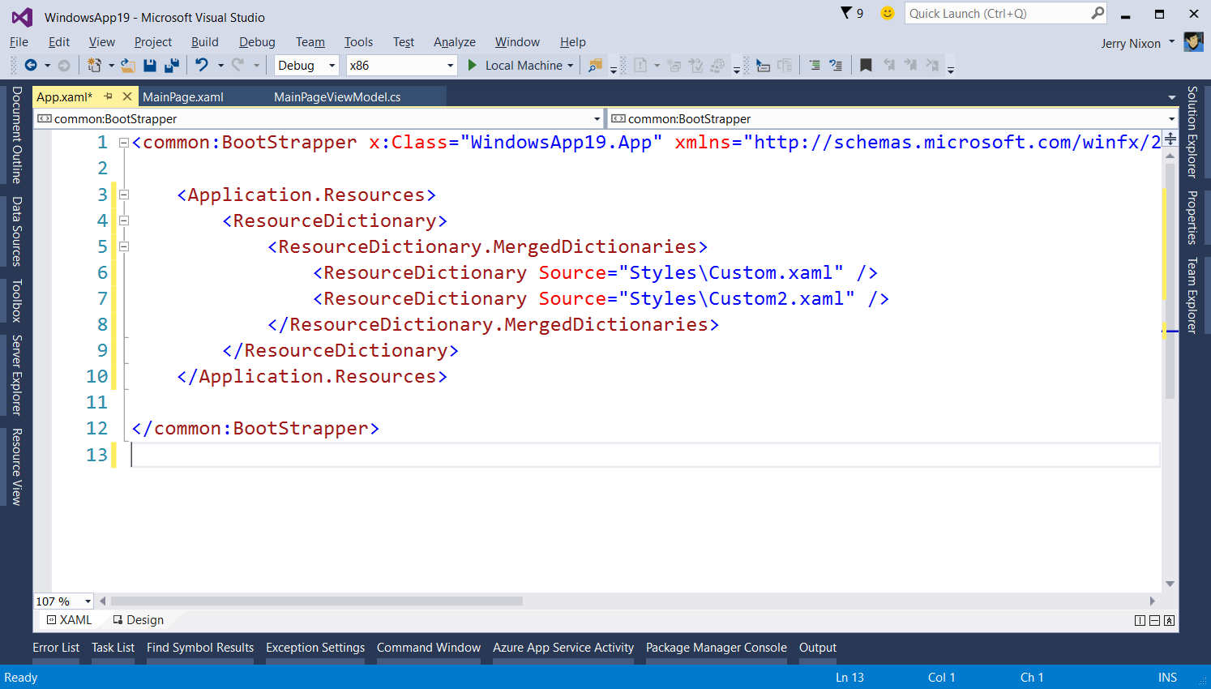
Merging dictionaries

Slide 23
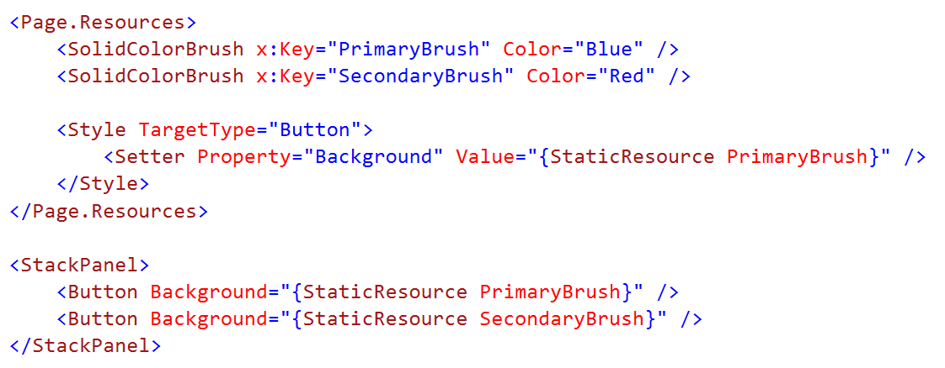
Values as resources

Slide 24
Managing resources in Blend

Slide 25
Summary
Styling basics
Let's play a game
Advanced styling

